Slide 1
Machine Learning with Python

Slide 2
Computational Problems
The practice of engineering is applying science to solve a problem. There are 2 kinds of problems:
Deterministic: These are the set of problems which have a pre-defined set of steps which solve them, every time. E.g software written to dispense currency from an ATM machine. Whatever be the case, the software executes the same steps everytime to dispense the currency.
Non-Deterministic: There are many problems where the solution is not deterministic. This is because either we don’t know enough about the problem or we don’t have enough computing power to model the problem. E.g how to classify whether a mail is spam or not. There is no single formula to determine a spam mail. It depends on the occurrence of certain words used together, length of email and other factors. Another example can be how to measure the happiness of humans. The solution to this problem will differ greatly from 1 person to another. For such cases, STATISTICS will come into play.
Now, we can approach to solve Non-deterministic problems by using a pre-defined set of rules but it will not work for all the cases. You can define few rules to classify a mail as SPAM or HAM and it may work on a given set of mails but a new mail may arrive which may not follow the rules. In this case, you will have to modify the rules again.
Machine Learning is an approach which uses data to identify patterns(learning) and solves the problem based on this learning. As new data comes in, the machine learning algorithm adjusts itself based on the data and start giving out results as per the new learning.

Slide 3
Statistics - Refresher
Statistics is the science of collecting, organizing, summarizing, analyzing and interpreting data.
Descriptive Statistics: When performing descriptive statistics you collect, organize, summarize, and graphically present data; then you are able to make conclusions about said data.
Inferential Statistics: Inferential statistics are used when you want to make predictions and inferences about a larger group (a whole population) from data that was collected from a smaller group (a sample population)
Measures of Central Tendency: Mean, median and Mode
Measures of Dispersion: Range, Interquartile Range and Standard Deviation
Population: Statisticians refer to an entire group that is being studied as a population. Each member of the population is called a unit, or subject. Different characteristics or attributes of a unit or subject are known as variables.
Sample: Smaller, representative group from the population, is called a sample. An actual value of a population variable A measurable characteristic of a population, such as a mean or standard deviation, is called a parameter; but a measurable characteristic of a sample is called a statistic.
Error (or disturbance) of an observed value is the deviation of the observed value from the true value of a quantity of interest(e.g population mean)
Residual of an observed value is the difference between the observed value and the estimated value of the quantity of interest (for example, a sample mean)
Research or Study: It can be Observational or Experimental(Interventional). In an observational study you are not giving the subjects any type of treatment, you are just recording what you observe. In an experiment, you are giving the subjects a treatment and observing the effects of that treatment.
A retrospective study is an observational study in which you look at past data. Typically used when you are studying something that is unethical (such as drinking during pregnancy). A prospective study is an observational study in which you observe over a significant period of time. This is used when you want to study long term effects.

Slide 4
Statistics - Variables
Quantitative variables take numerical values whose "size" is meaningful. Quantitative variables answer questions such as "how many?" or "how much?"
For example, it makes sense to add, to subtract, and to compare two persons' weights, or two families' incomes: These are quantitative variables. Quantitative variables typically have measurement units, such as pounds, dollars, years, volts, gallons, megabytes, inches, degrees, miles per hour, pounds per square inch, BTUs, and so on.
Qualitative Variables: Some variables, such as social security numbers and zip codes, take numerical values, but are not quantitative: They are qualitative or categorical variables. The sum of two zip codes or social security numbers is not meaningful. The average of a list of zip codes is not meaningful. Qualitative and categorical variables typically do not have units. Qualitative or categorical variables—such as gender, hair color, or ethnicity—group individuals. Qualitative and categorical variables have neither a "size" nor, typically, a natural ordering to their values. They answer questions such as "which kind?" The values categorical and qualitative variables take are typically adjectives (for example, green, female, or tall). Arithmetic with qualitative variables usually does not make sense, even if the variables take numerical values. Categorical variables divide individuals into categories, such as gender, ethnicity, age group, or whether or not the individual finished high school

Slide 5
Levels of Measurement
There are 4 levels of measurement: Nominal, Ordinal, Interval and Ratio.
A nominal measurement is one in which the values of the variable are names. The names of the different species of Galapagos tortoises are an example of a nominal measurement. These variables are categorical. Nominal variables are organized into non-numeric categories that cannot be ranked or compared quantitatively. This type of data is often referred to as qualitative. Appropriate mathematical operation: counting the number of cases per category
An ordinal measurement involves collecting information of which the order is somehow significant. E.g tracking student grades
With interval measurement, the distance between any two values has a specific meaning. E.g difference in temperature. Addition and Subtraction can be done for interval variables but multiplication and division is not possible because zero is arbitrary in this level of measurement.
A ratio measurement is the estimation of the ratio between a magnitude of a continuous quantity and a unit magnitude of the same kind. The ratio between any two values has meaning, because the data includes an absolute zero value

Slide 6
Sampling
The process of extracting samples from population is called sampling. 5 sampling methods are:
Random – every member of the population has an equally likely chance of being chosen
Systematic – there is a system to choosing the sample such as every 20th member
Convenience – Using a group that is convenient such as the first 25 people that walked into the room
Cluster – choosing random subgroups from the population and choosing everyone in those subgroups
Stratified – choosing random members out of every subgroup in the population
Errors in Sampling: Estimates derived from sampling are prone to inaccuracies. This cannot be avoided until and unless the entire population is used. The difference between the true parameter and the statistic obtained by sampling is called sampling error

Slide 7
Common Terms
Distribution: The pattern of values in the data, showing their frequency of occurrence relative to each other.
Function: A function is a relationship where each input number corresponds to one and only one output number
Model: A model is a formula where one variable (response or outcome variable) varies depending on one or more independent variables (covariates). A model tries to establish a relationship among data points. One of the simplest models we can create is a Linear Model where we start with the assumption that the dependent variable varies linearly with the independent variable(s). Linear Model has a “constant” rate of change. An exponential Model has a “constant percent” rate of change. So if a population grows by 10 people per year(given the initial population as 100), it’s a linear growth and the model will be:
P(t)=100+10t
But if a population grows by 10% each year(given the initial population as 100), its an exponential growth and the model will be
P(t)=100(1+10%)^t
Histogram:
A histogram is a figure that shows how a quantitative variable is distributed over all its values. It allows for the variable to be “binned” into unequal intervals. It gives the frequency distribution of a given variable.
A histogram plots 1 Dimensional data. The common graph for categorical data to represent counts for each category is a bar plot while the common graph for numerical data to represent the frequency for each value (or bin) is a histogram

Slide 8
Measures of Central Tendency
Central tendency refers to the most typical value in a set of numbers
Median is the half-way point of data. The median is the number that divides the (ordered) data in half—the smallest number that is at least as big as half the data. At least half the data are equal to or smaller than the median, and at least half the data are equal to or greater than the median. If the distribution is skewed, median is typically used to describe the center. Median is appropriate for ordinal, interval and ratio variables but not for nominal variables.
Mode: The value that has highest frequency. Most frequently occurring value in the data set or the most popular value. It’s the only measure of central tendency that can be used with nominal variables. Though its also appropriate for ordinal,interval and ration variables.
Mean: The mean (more precisely, the arithmetic mean) is commonly called the average. It is the sum of the data, divided by the number of data. If there are outliers in data, mean can be strongly influenced. In such cases, median is more appropriate. The data point at Ratio level of measurement is a candidate for Mean calculation
For qualitative and categorical data, the mode makes sense, but the mean and median do not

Slide 9
Some more Terms…
Percentiles: Assume that the elements in a data set are rank ordered from the smallest to the largest. The values that divide a rank-ordered set of elements into 100 equal parts are called percentiles.
Quartiles:
The median of a data set is located so that 50% of the data occurs to the left of the median (and 50% of the data occurs to the right of the median). There is no reason to restrict our attention to the 50% level. For example, we can find a point where 25% of the data occurs on its left and 75% to its right. These points are known as the “first quartile” and “third quartile” respectively

Slide 10

Measures of Dispersion
These measure the extent of variability in data. Range, interquartile range and standard deviation are the three
commonly used measures of dispersion.
Range: Difference between the largest and smallest observation in the data.
Inter-quartile Range(IQR): Difference between the 25th and 75th percentile. It describes the middle 50% of the observations.
Standard Deviation: It is the measure of spread of data about the mean. It measures roughly how far off the entries are from their average. It tells us how the data is spread out. The more the SD, the more spread out data is. Since its simply a measure, it can’t be negative.
When you add a constant to a list of values, the average also adds up by constant but the SD doesn’t change. If you multiply by a constant, the new average and new SD also get multiplied by that constant.
Variance: Mean of Squared deviations. Or simply, it’s the square of Standard deviation.
Outlier: An outlier is a data point that lies outside the general range of the data. In the presence of outliers, the mean of the dataset will be significantly affected. In such cases, median makes for sense.
Outlier < Q1 – 1.5*(IQR)
Outlier > Q3 + 1.5*(IQR)

Slide 11
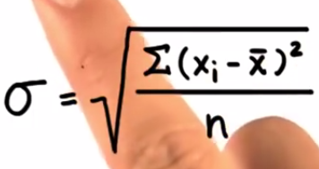
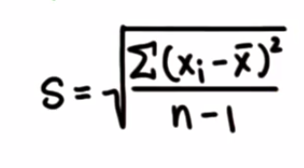
Bessel’s Correction
Standard deviation of the whole population is:
If we have a sample and we want to estimate the standard deviation of the whole population, we will calculate it as follows:
This is because a sample is chosen from the population where most data lies. The standard deviation using “n” as denominator will not capture all variability of the population. To estimate the correct variability of whole data using this sample, we will use (n-1) in the denominator to increase the overall value by some margin.

Slide 12
Some more Terms…
Box and Whisker Plot: It’s a visual representation of Min, Max, Median and quartiles on a single graph. Its mainly used for identifying outliers easily.
Markov’s Inequality: If a list has only non-negative entries, then the proportion of entries that are atleast as large as k times the average is atmost 1/k.
Significance of SD: SD gives you an insight that how much your data is spread out. With the help of SD you can compare 2 datasets more effectively. If the average of 2 data sets is same, it does not means that the SD will be same. E.g 99,100,101 and 0 , 100 , 200 have same mean i.e 100 but they have different standard deviations. The SD of (99,100,101) is only 1 but the SD of (0,100,200) is 100 which is very large.
Lets say the average starting salary in a company is 80000$. Would you consider joining it? There may be few outliers which may have skewed the average. Additionally, if you know that SD is 2000$, you may consider joining it.
Z Score: A z-score is the measure of the number of standard deviations a particular data point is away from the mean i.e how many standard deviation away from mean is the observed value. Its also called Z-value
Z = Deviation from mean/Standard Deviation

Slide 13

Covariance
Variance and Standard Deviation only operate on 1 dimension so that you could only calculate the standard deviation for each dimension of the data set independently of the other dimensions. There should be a measure to find out how much the dimensions vary from the mean with respect to each other. Covariance is such a measure. Covariance is always measured between 2 dimensions.
If you calculate the covariance between one dimension and itself, you get the variance.

Slide 14
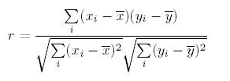
Corelation
Correlations are mathematical relationships between variables. Correlation Coefficient (r) is a number between -1 and 1. It measures linear association i.e how tightly the points are clustered about a straight line. The correlation is said to be linear if the data points lye in an approximately straight line.
A correlation between two variables doesn’t necessarily mean that one caused the other or that they’re actually related in real life. A correlation between two variables means that there’s some sort of mathematical relationship between the two. This means that when we plot the values on a chart, we can see a pattern and make predictions about what the missing values might be. What we dont know is whether there’s an actual relationship between the two variables, and we certainly don’t know whether one caused the other, or if there’s some other factor at work.
Correlation = Covariance(X,Y) / SQRT( Var(X)* Var(Y))
.

Slide 15
Multi-colinearity
.
Multi-colinearity refers to the situation when 2 independent variables are highly correlated. Multi-collinearity generally degrades the performance of linear regression model.
Multi-collinearity means that several variables are essentially measuring the same thing. It doesn't add to the predictive capability of the model and it may make the model fit less well. Since you are predicting an outcome, you want your factors to be independent. Correlation indicates two or more factors are providing your model with similar data which will decrease the model's ability to accurately predict.
Example: Predicting home prices. Square feet and number of bedrooms could be two of your factors considered. But logically you could see how these two measurements would be correlated; likely positive correlation. What if a home you want to predict for only has one room but the sqft of a 5 bedroom home? Your model is 'expecting' 5 bedrooms and that bedrooms add value to the home. Your model will predict price using one room but not as accurately as it would if the bedrooms only slightly varied from your model. Your model would more accurately predict the price if, in this example, bedrooms were removed AND the regression model was created again.

Slide 16
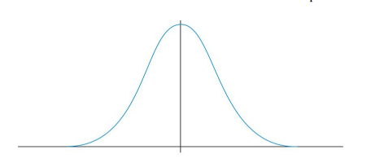
The NORMAL Distribution
In real world, the following type of distribution is very commonly seen:
/
The x-axis is the value of the random variable.
The y-axis is the probability it can take
e.g try measuring the height of the employees in your company. In most situations, there will be couple of employees with very low measurements, couple of employees with very large measurements and most of them centred on a particular value. Since this pattern is so frequently seen, it is called as normal distribution.
The peak value is called the Mean or Average. The width of the curve defines the spread of the variable and is defined by a parameter called “Standard Deviation”
Mean and SD are usually sufficient to completely describe a Normal Distribution. Given these 2 numbers , one can calculate the probability of a random variable by using Standard Tables. But before assuming that a random variable follows Normal Distribution, you need to perform certain tests for Normality
P-value: The basic notion of this concept is, a number representing results by chance. Smaller the number, more reliable are the results. Generally 0.05 is considered the threshold, P-value less than that is reliable. So a P-value of 5% or 0.05 tells us, 1 out of every 20 results will be produced by chance.

Slide 17
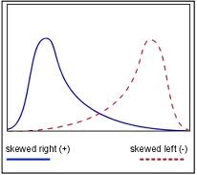
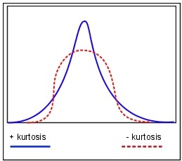
The Normal Distribution
Central Limit Theorem:
Regardless of the underlying distribution, if we draw large enough samples and plot each sample mean then it approximates to normal distribution. The Empirical Rule states that the percentages of data in a normal distribution within 1, 2, and 3 standard deviations of the mean are approximately 68%, 95%, and 99.7%, respectively.
Skewness and Kurtosis are the other two characteristics used to understand a distribution. Skewness is a measure of the asymmetry. Negatively skewed curve has a long left tail and vice versa. Kurtosis is a measure of the "peaked ness". Distributions with higher peaks have positive kurtosis and vice-versa. Following diagrams will make this parameter clearer

Slide 18
Random Variables
A random variable is a variable whose value is subject to variations due to chance i.e randomness. (also known as stochastic variable) It can be of 3 types:
> Discrete: It can take only integer values e.g [0,1,-1,2,3,4]
> Continuous: It can take any value from a range of values
> Categorical: It can only take a value from a fixed set of values
The actual value of a random variable can not be determined beforehand. However the range of values it can take can be pre-dertermined. E.g the roll of a dice, length of a tweet, no of leaves on a tree etc
A Statistical Experiment is an experiment whose set of outcomes can be specified beforehand but the actual outcome of the experiment is subject to chance. E.g throwing a dice, flipping a coin etc. The outcome variable of the statistical experiment is usually a random variable. It is denoted by X. e.g in the experiment of flipping a coin, the result of tossing is a random variable which can have 2 outcomes: Heads or Tails

Slide 19
Probability Distribution
A Probability Distribution is a table or function which links each outcome of a statistical experiment with its probability of occurrence.
Lets take a statistical experiment where in we are picking up a user at random from the entire group of Facebook Users. We have the data tracking the country of users which login into facebook each day. Here Country is the random variable. The % users logging in are as follows:
Now we can get the probability if the user picked belongs to USA
P(X=”USA”)= 10/100 = 0.1
If the probabilities of each outcome of a statistical experiment are same, it is said to belong to Uniform Probability Distribution. E.g the experiment of throwing a dice. Each outcome has a probability of 1/6.
Depending upon the type of Random Variable, the probability distribution can also be Discrete or Continuous
Country | % of Users
USA | 10%
India | 7%
Brazil | 5%
Indonesia | 4%
Others | 74%

Slide 20
Relationship between 2 variables
While dealing with 2 variables, we seek to find out the value of 1 variable influences the value of other variable. For instance, does the amount of time spent studying (first variable) influence grades on an exam (second variable)? The first step in determining the relationship between 2 variables is to determine the causal order. For instance, in the relationship between time spent studying and exam grades, it’s entirely possible that the amount of time a student spends studying can influence her exam grade (although it might not), but it’s not possible for her exam grade to influence the amount of time she spent studying for that exam. In this example, the first variable (study time) precedes the second (grade), so it is straightforward to determine the causal order. The first variable could influence the second, but the second could not influence the first. In other cases, the causal order is not so clear. For instance, think about the relationship between the number of friends one has and the number of parties one attends. It is possible that the number of friends a person has influences how many parties he attends, because the more people he knows, the more parties he can be invited to. However, it’s also possible that the relationship could work the other way – that the more parties a person attends, the more friends he will have. It could also be true that attending parties gives people the opportunity to meet new people. In this case, the causal order isn’t so clear (which comes first?).
The variable which is being influenced is called the dependent variable and the one that is influencing it is called the independent variable.

Slide 21
Hypothesis
The hypothesis that states the expectation of a meaningful or statistically significant relationship between variables as the “research hypothesis”. The hypothesis that suggests that the relationship between variables is not strong enough, or the differences are not large enough, to be considered statistically significant, as the “null hypothesis”.
False Positive – Type 1 error
False Negative – Type 2 error

Slide 22
Analytics Landscape
Reporting: A report describes what events have happened in the business. It provides what is asked for and is typically standardized. A monthly sales summary report shows monthly sales by region.
Analysis: An analysis tries to answer why the events happened in the business have happened. E.g an analysis of sales summary report may show sales peaks on specific holidays or weekends. Basic Analytics involves slicing and dicing of data, monitoring large volumes of data in real time and anomaly detection
Advanced Analytics: Advanced analytics extends the insights provided by analytics by doing impact analysis on the business and prescribing the next steps which can be taken. It includes predictive modeling, text analytics and advanced data mining algorithms. The purpose of any "data analysis" is to derive meaningful information from it. One way to extract information from data is to study the variability in data points. The more is the variability, the more careful you have to study or explore the dataset, so that you can capture all of its meaning.
Data Science: Data science is about using data to make decisions that drive actions.
Data science involves:
Finding data
Acquiring data
Cleaning and transforming data
Understanding relationships in data
Delivering value from data
Forecasting is a process of estimating the future based on past events. It’s at a high level. E.g no of calls expected in a call center, no of passengers expected to travel from an airport next month etc
Predictive modeling is doing the prediction or estimation at a more granular level. E.g which customers are expected to buy the printer in next 30 days.

Slide 23
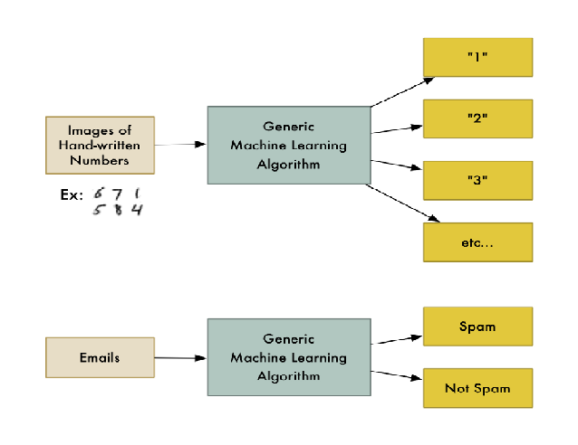
Machine Learning
Machine Learning is the name given to generalizable algorithms that enable a computer to carry out a task by examining data rather than hard programming.
Its a subfield of computer science and artificial intelligence that focuses on developing systems that learn from data and help in making decisions and predictions based on that learning. ML enables computers to make data-driven decisions rather than being explicitly programmed to carry out a certain task.

Slide 24
Types of Machine Learning
a. Supervised Learning: These are “predictive” in nature. The purpose is to predict the value of a particular variable(target variable) based on values of some other variables(independent or explanatory variables). Classification and Regression are examples of predictive tasks. Classification is used to predict the value of a discrete target variable while regression is used to predict the value of a continuous target variable. To predict whether an email is spam or not is a Classification task while to predict the future price of a stock is a regression task.
They are called supervised because we are telling the algorithm what to predict.
b. Unsupervised Learning: These are “descriptive” in nature. The purpose is to derive patterns that summarize the underlying relationships in data. Association Analysis, Cluster Analysis and Anomaly detection are examples of Unsupervised Learning. They are called unsupervised because in such cases, the final outcome is not known beforehand. With unsupervised learning there is no feedback based on the prediction results.

Slide 25
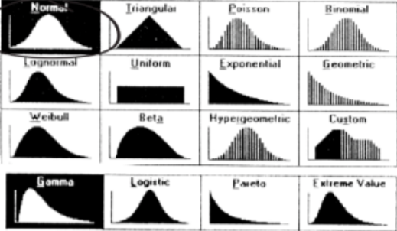
Probability Distributions and ML
The “features” that we select in a Machine Learning problem are generally Random Variables
Many Machine Learning techniques makes assumptions about what are the probability distributions of these random variables
Statisticians and Mathematicians have studied a lot of random variables in nature and realized that there are some recurrent themes. They have defined some standard distributions and most random variables that are encountered fall into one of these standard distributions.

Slide 26
Doing Analytics – Step by Step
Understand the Business Process
Understand the data involved in that Business process – Data Profiling & Exploration
Modeling
Testing and Validation
Deployment

Slide 27
Data Exploration Steps
Identify the variables (Predictor and Target)
Univariate Analysis
Bivariate Analysis
Handling Missing Values
Handling Outliers
Variable Transformation
Variable Creation

Slide 28
Predict the type??
Non Acerous | Acerous
Goat | Elephant
Lamb | Parrot
Buffalo | Dog
Stag | Cat
Girraff
What is a horse? Acerous or Non-Acerous
What can be the Features?
What is the Label?

Slide 29
SPAM or HAM Emails
Email Comes In
ML-Based Spam Classifier
A Large Body of Pre-Classified Spam and Ham Emails
Decision: Spam or Ham

Slide 30
SPAM or HAM?
CORPUS: A set of emails already marked as SPAM or HAM
Depending upon the frequency of a word in an email, we will determine the spamminess or hamminess of a word. If a word appears more no of times in a Spam email, its spamminess measure is high
S(T) = C(T-Spam)/[C(T-Spam) + C(T-Ham)]
Where C(T-Spam) = No of Times the word appears in all Spam Emails
C(T-Spam) + C(T-Ham) = No of times the word appears in any email
If a new mail comes up:
Find out the spamminess of each word of that mail.
Find the total spamminess of the entire message S(M)=S(T1)*S(T2)……*S(T(n))
Find the hamnminess of entire message H(M)=[1-S(T1)]*[1-S(T2)]…….*[1-S(T(n)]
If S(M) > H(M), the decision will be that the message is Spam else its is Ham
This method depends on the pre-existing corpus. We are training our Model on the corpus where we are finding the spamminess of each word. Then we are running a new email against this model to take the decision.

Slide 31
Supervised Learning : Classification
Machine Learning techniques that explicitly have a “Training the model” stage are examples of Supervised Learning.
When the decision to be made is “discrete” value (e.g a mail can be either Spam or Ham”), this is known as Classification
The entities we are seeking to classify are called “problem instances”. The emails that are coming as input are our problem instances
Each problem instance is represented using some attributes. In our example Email was represented using words in it. The observable attributes of each problem instance are called features or Feature Vectors.
The categories we seek to classify are called “Labels”
An algorithm that implements Classification is called a Classifier e.g Naïve-Bayes, K-Nearest Neighbour, Support Vector Machine

Slide 32
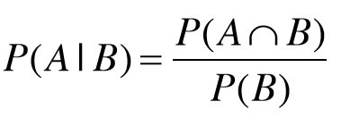
Probability
Probability—the degree of belief in the truth or falsity of a statement
Range of uncertainty from 0 to 1
Certain statement is true: probability 1
Certain statement is false: probability 0
Probability of a person picked up randomly in a company being a female = ½
Now lets say that the HR department consist of 86% of the females .
So, the probability of a person picked up randomly in a company being a female AND working in HR department = 0.86
This called Posterior Probability = P(h|D) = Probability of hypothesis h, given some data D
P(female|works in HR department)= 0.86
It is also known as conditional probability.

Slide 33
Probability
Probability of events occurring in an order or the probability of group of events occurring
Permutation: Order matters e.g placing 5 people in 5 different positions (120 ways)
Combination: Order does not matter e.g forming a 5 person team from 5 people – 1 way

Slide 34
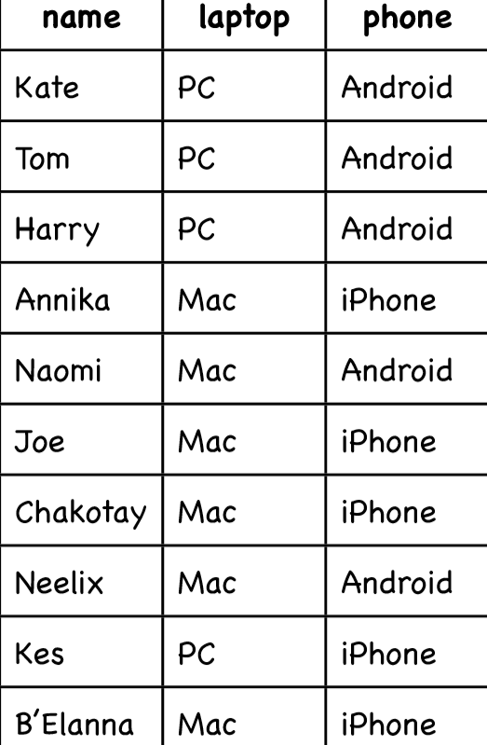
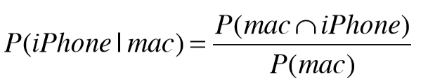
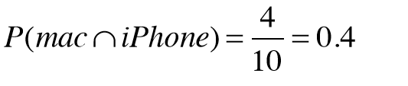
Probability – An example
Probability that a randomly selected person uses an iPhone:
P(iPhone)= 5/10 = 0.5
What is the probability that a randomly selected person uses an iPhone given that person uses a Mac laptop?
there are 4 people who use both a Mac and an iPhone:
and the probability of a random person using a mac is P(mac)= 6/10
So the probability of that some person uses an iPhone given that person uses a Mac is
P(iphone|mac) = 0.4/0.6 = 0.667

Slide 35
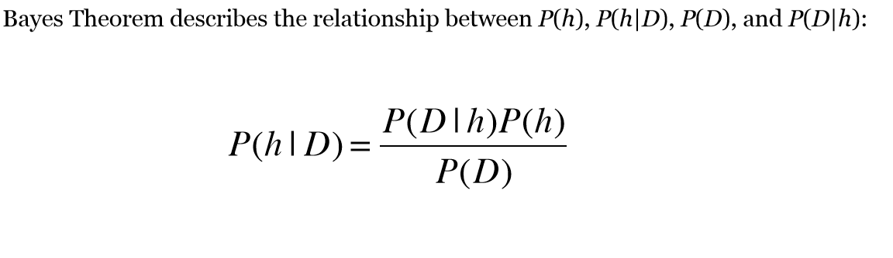
Bayes Theorm
0.8% of the people in the U.S. have diabetes. There is a simple blood test we can do that will help us determine whether someone has it. The test is a binary one—it comes back either POS or NEG. When the disease is present the test returns a correct POS result 98% of the time; it returns a correct NEG result 97% of the time in cases when the disease is not present.
Suppose a patient takes the test for diabetes and the result comes back as Positive. What is more likely : Patient has diabetes or Patient does not have diabetes?

Slide 36
Bayes Theorem
P(disease) = 0.008
P(~disease) = 0.992
P(POS|disease) = 0.98
P(NEG|disease) = 0.02
P(NEG|~disease)=0.97
P(POS|~disease) = 0.03
P(disease|POS) = ??
As per Bayes Theorm:
P(disease|POS) = [P(POS|disease)* P(disease)]/P(POS)
P(POS) = P(POS|disease)* P(disease)] + P(POS|~disease)* P(~disease)]
P(disease|POS) = 0.98*0.008/(0.98*0.008 + 0.03*0.992) = 0.21
P(~disease|POS) = 0.03*0.992/(0.98*0.008 + 0.03*0.992) = 0.79
The person has only 21% chance of getting the disease

Slide 37
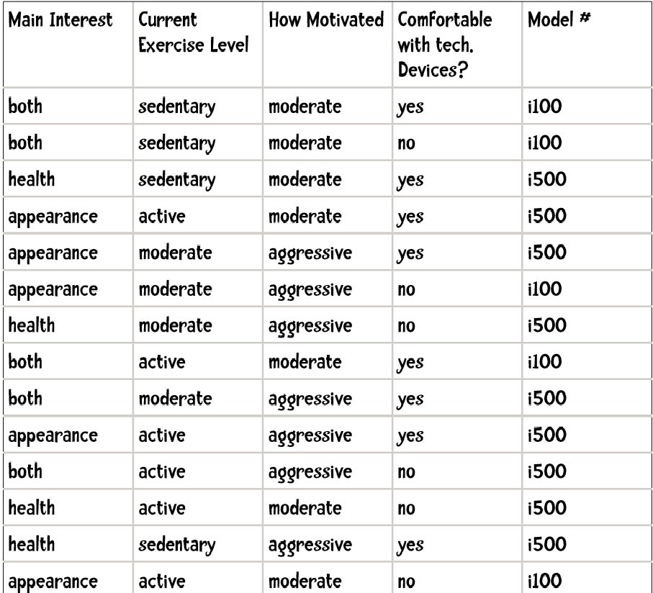
Bayes Theorem as Classifier
Using the naïve Bayes method, which model would you recommend to a person whose main interest is health current exercise level is moderate is moderately motivated and is comfortable with technological devices

Slide 38
Bayes Theorem as Classifier
We will have to calculate:
P(i100 | health, moderateExercise, moderateMotivation, techComfortable)
AND
P(i500 | health, moderateExercise, moderateMotivation, techComfortable)
We will pick the model with the highest probability
P(i100 | health, moderateExercise, moderateMotivation, techComfortable) will be equal to the product of :
P(health|i100),P(moderateExercise|i100),P(moderateMotivated|i100),
P(techComfortable|i100)P(i100)
P(health|i100) = 1/6
P(moderateExercise|i100) = 1/6
P(moderateMotivated|i100) = 5/6
P(techComfortable|i100) = 2/6
P(i100) = 6 / 15
so P(i100| evidence) = .167 * .167 * .833 * .333 * .4 = .00309

Slide 39
Bayes Theorem as Classifier
Now we compute
P(i500 | health, moderateExercise, moderateMotivation, techComfortable)
P(health|i500) = 4/9
P(moderateExercise|i500) = 3/9
P(moderateMotivated|i500) = 3/9
P(techComfortable|i500) = 6/9
P(i500) = 9 / 15
P(i500| evidence) = .444 * .333 * .333 * .667 * .6 = .01975
So, the ouput will be i500

Slide 40
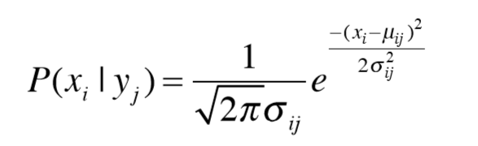
Naïve Bayes in case of Numerical Attributes
Naïve Bayes works well for categorical data.
In case of a numerical(continuous) attribute, we can do 2 things:
Make categories
So Age can be categorized as <18, 18-22, 23-30, 31-40, >40
Gaussian Distribution
Naïve Bayes assumes that the attribute follow a Normal Distribution. We can use Probability density function to compute the probability of the numerical attribute

Slide 41
kNN Algorithm
K – Nearest Neighbours:
We have a set of training data with labels. When we are given a new piece of data, we compare it to every piece of existing data. We then take the most “similar” pieces of data(the nearest neighbours) and look at their labels. We look at the top “k” most “similar” pieces of data from training set. Lastly, we take a majority vote from these k pieces and assign the majority class to our new piece of data.
How to calculate “similarity” between 2 pieces of data?
We can represent each piece of data as a point and calculate the distances between those points. The pints which are close to each other can be considered as “similar”

Slide 42
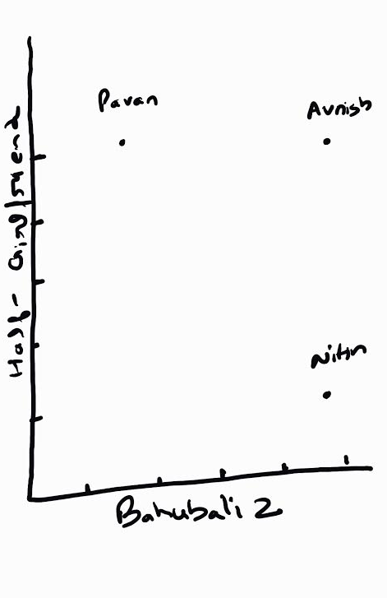
Example
We have some users who have given ratings to 2 movies. We will calculate the distance between these users based on the ratings they gave to the movies.
Since, there are 2 movies – each user can be represented as point in 2 dimensions
User | Bahubali 2 | Half-Girlfriend
Avnish | 5 | 5
Pawan | 2 | 5
Nitin | 5 | 1
Aishwarya | 5 | 4

Slide 43
Distances
Manhattan Distance:
This is the easiest distance to calculate.
So lets say Aishwary is (x1,y1)
Pawan is (x2,y2)
Manhattan Distance is calculated by : |x1 – x2| + |y1 – y2|
So distance between Aishwary and Pawan is |5 – 2| + |5 – 4| = 4
distance between Aishwary and Avnish is |5 – 5| + |5 – 4| = 1
distance between Aishwary and Nitin is |5 – 5| + |4 -1| = 3
Aishwarya is more similar to Avnish. So if we know the best rated movies of Avnish, we can recommend it to Aishwarya.

Slide 44

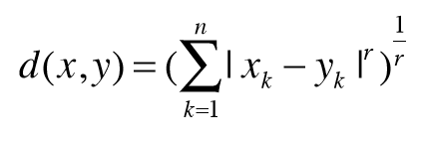
Distances
Euclidean Distance or As-the-Crow flies Distance:
We can also use Euclidean distance between 2 points using the below formula:
So distance between Aishwary and Pawan is 3.16
distance between Aishwary and Avnish is 1
distance between Aishwary and Nitin is 3
Minkowski Distance Metric:
Generalization:
When
• r = 1: The formula is Manhattan Distance.
• r = 2: The formula is Euclidean Distance
• r = ∞: Supremum Distance
Manhattan Distance and Euclidean Distance work best when there are no missing values

Slide 45
N - Dimensions
Previous example can be expanded into more than 2 dimensions where we can have more no of people giving ratings to many movies
In this case, distance between 2 people will be computed based on the number of movies they both reviewed e.g Distance between Gaurav and Somendra is
 | Gaurav | Somendra | Paras | Ram | Tomar | Atul | Sumit | Divakar
Bahubali-2 | 3.5 | 2 | 5 | 3 |  |  | 5 | 3
Half-Girlfriend | 2 | 3.5 | 1 | 4 | 4 | 4.5 | 2
Sarkar3 |  | 4 | 1 | 4.5 | 1 | 4
Kaabil | 4.5 |  | 3 |  | 4 | 5 | 3 | 5
Raees | 5 | 2 | 5 | 3 |  | 5 | 5 | 4
Sultan | 1.5 | 3.5 | 1 | 4.5 |  | 4.5 | 4 | 2.5
Dangal | 2.5 |  |  | 4 | 4 | 4 | 5 | 3
Piku | 2 | 3 |  | 2 | 1 | 4
 | Gaurav | Somendra | Difference
Bahubali-2 | 3.5 | 2 | 1.5
Half-Girlfriend | 2 | 3.5 | 1.5
Sarkar3 |  | 4
Kaabil | 4.5
Raees | 5 | 2 | 3
Sultan | 1.5 | 3.5 | 2
Dangal | 2.5
Piku | 2 | 3 | 1
Manhattan Distance |  |  | 9

Slide 46
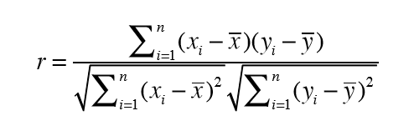
Pearson Corelation Coefficient
 | Gaurav | Somendra | Paras | Ram | Tomar | Atul | Sumit | Divakar
Bahubali-2 | 3.5 | 2 | 5 | 3 |  |  | 5 | 3
Half-Girlfriend | 2 | 3.5 | 1 | 4 | 4 | 4.5 | 2
Sarkar3 |  | 4 | 1 | 4.5 | 1 | 4
Kaabil | 4.5 |  | 3 |  | 4 | 5 | 3 | 5
Raees | 5 | 2 | 5 | 3 |  | 5 | 5 | 4
Sultan | 1.5 | 3.5 | 1 | 4.5 |  | 4.5 | 4 | 2.5
Dangal | 2.5 |  |  | 4 | 4 | 4 | 5 | 3
Piku | 2 | 3 |  | 2 | 1 | 4
Somendra avoids extremes. He is rating between 2 to 4. He doesn’t give 1 or 5
Atul seems to like every movie. He rates between 4 and 5
Tomar either gives 1 or 4
So its difficult to compare Tomar to Atul because both are using different scales(This is called grade-inflation) To solve this, we use Pearson Correlation Coefficient
The Pearson Correlation Coefficient is a measure of correlation between two variables. It ranges between -1 and 1 inclusive. 1 indicates perfect agreement. -1 indicates perfect disagreement
Formula

Slide 47
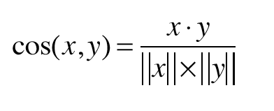
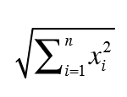
Cosine Similarity
X and y are the vectors.
Cos(x,y) finds the similarity between these 2 vectors
x.y is the dot product
||x|| is the length of the vector. It is equal to:

Slide 48
Which Similarity measure to use?
If the data contains grade-inflation, use Pearson coefficient
If the data is dense(almost all attributes have non-zero values) and the magnitude of the attribute value is important, use distance measures like Manhattan or Euclidean
If the data is sparse, use Cosine Similarity

Slide 49
Recommendation Systems
Some examples:
Facebook suggests you the list of names “People you may know”
Youtube suggests you the relevant videos
Amazon suggests you the relevant books
Netflix suggests you the movies you may like
A recommendation system seeks to predict the ‘rating’ or ‘preference’ that user would give to an item.
In today’s digital age, businesses often have hundreds of thousands of items to offer their customers
Recommendation Systems can hugely benefit such businesses

Slide 50
Filtering methods
Collaborative Filtering: The process of using other users’ inputs to make predictions or recommendations is called collaborative filtering. It requires lot of data and hence lots of computing power to make accurate recommendations.
An example
Content Filtering: The process of using the data itself (contents of data) to make predictions or recommendations is called content filtering. It requires limited data but can be limited in scope. This is because you are using the contents of data. So you end up recommending similar things to what user has already liked. So recommendations are often not very surprising or insightful.
Netflix uses a hybrid system – both Collaborative and Content Filtering
 | Body Guard | Men in Black | Inception | Terminator
Kapil | 5 | 4 | 5 | 4
Mradul | 4 |  | 2 | 5
Saurabh |  | 5 | 4 | 4
Atul | 4 | 2

Slide 51
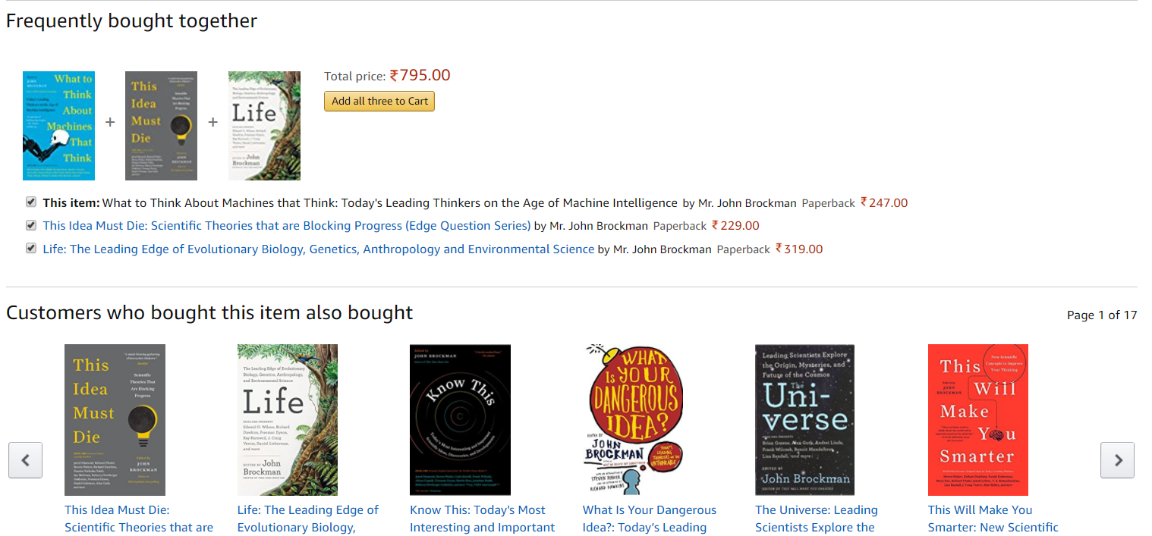
Recommendation Systems

Slide 52
Ways to Recommend
By using User Ratings for Products: Collaborative Filtering
By using Product Attributes : Content Based Filtering
By using Purchase Patterns: Association Rules Learning
What users bought?
RECOMMENDATION ENGINE
If you liked that, you will love this?
What users surfed?
People who bought that, also buy this…
What users liked and rated?
Top Pics for you!!
What users clicked?

Slide 53
Tasks performed by a Recommendation Engine
Filter relevant Products
1
Predict whether a user will buy a product
2
Predict what rating the user would give to Product
3
Rank products based on their relevance to user
4
Relevant products:
“Similar” to the ones user “liked” (e.g if a user liked a machine learning book, show him other books on machine learning)
“Liked” by “similar” users (e.g if 2 users liked 3 same movies, show a different movie liked by user1 to user2)
“Purchased” along with the ones user “liked” (e.g somebody bought camera, show him tripods)

Slide 54
Collaborative Filtering
Cons:
Scalability: if the no of users is very high, say 1 million, every time you want to make a recommendation for someone you need to calculate one million distances (comparing that person to the 999,999 other people). If we are making multiple recommendations per second, the number of calculations get extreme.
Sparsity: Most recommendation systems have many users and many products but the average user rates a small fraction of the total products. For example, Amazon carries millions of books but the average user rates just a handful of books. Because of this, the algorithm may not find any nearest neighbors.

Slide 55
Cross-Validation
Cross-Validation is a process of leaving a sample on which you do not train the model and test the model on this sample.
To do 10-fold cross validation:
we divide the training data equally into 10 sets.
Train the model over 9 sets, while holding back the 10th set
Test the model on the set which is held back and save the results
Repeat the process 9 more times by changing the data set which is held back
Average out the results
The result is a more reliable estimate of the performance of the algorithm on new data. It is more accurate because the algorithm is trained and evaluated multiple times on diﬀerent data. The choice of k must allow the size of each test partition to be large enough to be a reasonable sample of the problem, whilst allowing enough repetitions of the train-test evaluation of the algorithm to provide a fair estimate of the algorithms performance on unseen data. For modest sized datasets in the thousands or tens of thousands of records, k values of 3, 5 and 10 are common.

Slide 56
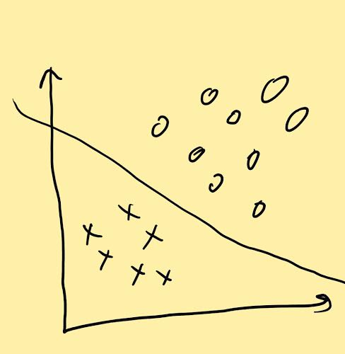
Support Vector Machines(SVM)
SVM is a supervised machine learning approach used to build linear, non-probabilistic binary classifiers.
It makes the classification decision based on a linear function
It does not involves any assumptions about the distribution of data
SVM finds a hyper-plane that cuts the data points into 2 categories. It’s a decision surface determined by observing the data points

Slide 57
Support Vector Machines(SVM)
The equation describing the hyper-plane will be as follows:
D = Ax + By + Cz
All points on one side of the plane will satisfy the condition
Ax + By + Cz > D
All points on the other side of the plane will satisfy the condition
Ax + By + Cz < D
SVM will choose that decision boundary which has maximum distance from the closest data point on either side of boundary. This distance is called “margin”. So SVM tries to maximize the “margin”.
Support vectors are simply the “nearest data points” on each side which “support” the hyperplane.
SVM is like a solver to an optimization problem. The objective function here is to find the decision boundary. The constraint is that it should not misclassify the data points.

Slide 58
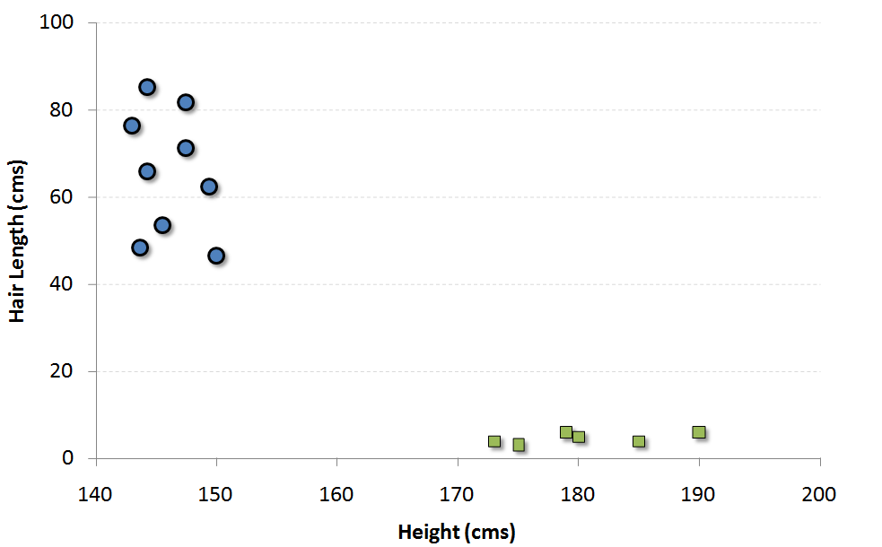
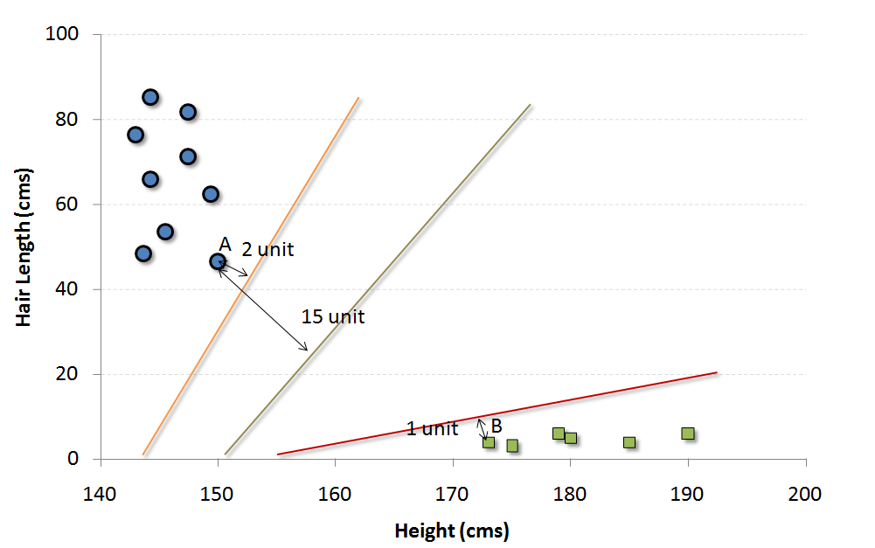
SVM - Example
The blue circles in the plot represent females and green squares represents male. A few expected insights from the graph are :
1. Males in our population have a higher average height.
2. Females in our population have longer scalp hairs.
If we were to see an individual with height 180 cms and hair length 4 cms, our best guess will be to classify this individual as a male.
The easiest way to interpret the “objective function” in a SVM is to find the minimum distance of the frontier from closest support vector (this can belong to any class). For instance, orange frontier is closest to blue circles. And the closest blue circle is 2 units away from the frontier. Once we have these distances for all the frontiers, we simply choose the frontier with the maximum distance (from the closest support vector). Out of the three shown frontiers, we see the black frontier is farthest from nearest support vector (i.e. 15 units).

Slide 59
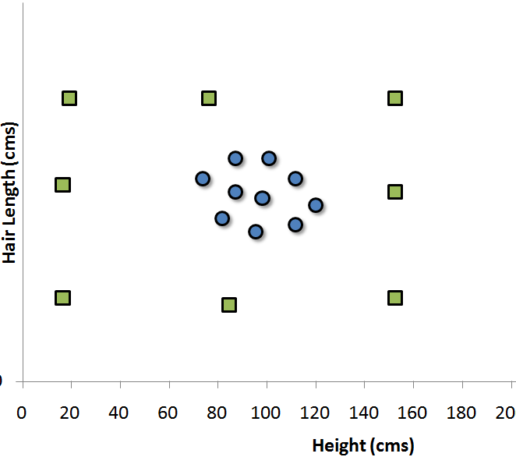
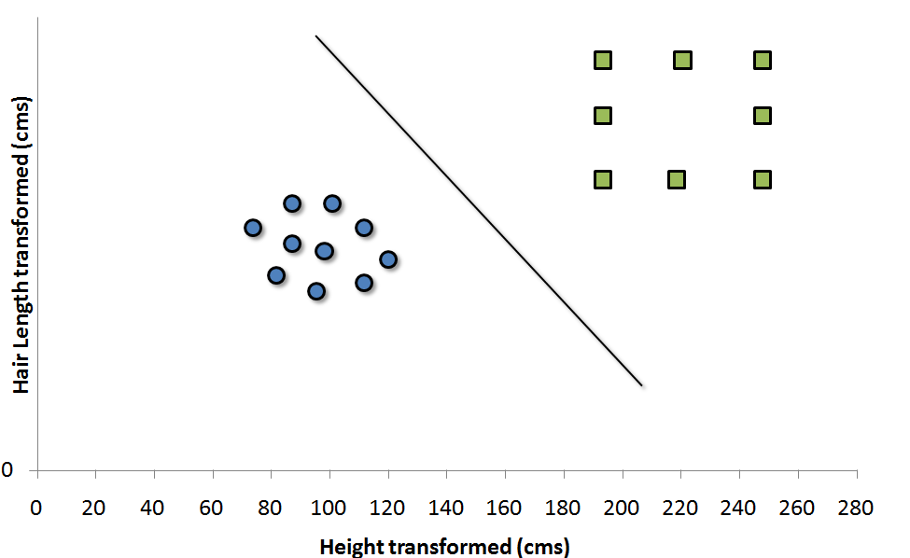
Non-Linear SVM
If the distribution of data points is such that its impossible to find linear separation between the 2 clusters, then we need to map these vector to a higher dimension plane so that they get segregated from each other.
Each of the green square in original distribution is mapped on a transformed scale. And transformed scale has clearly segregated classes.

Slide 60
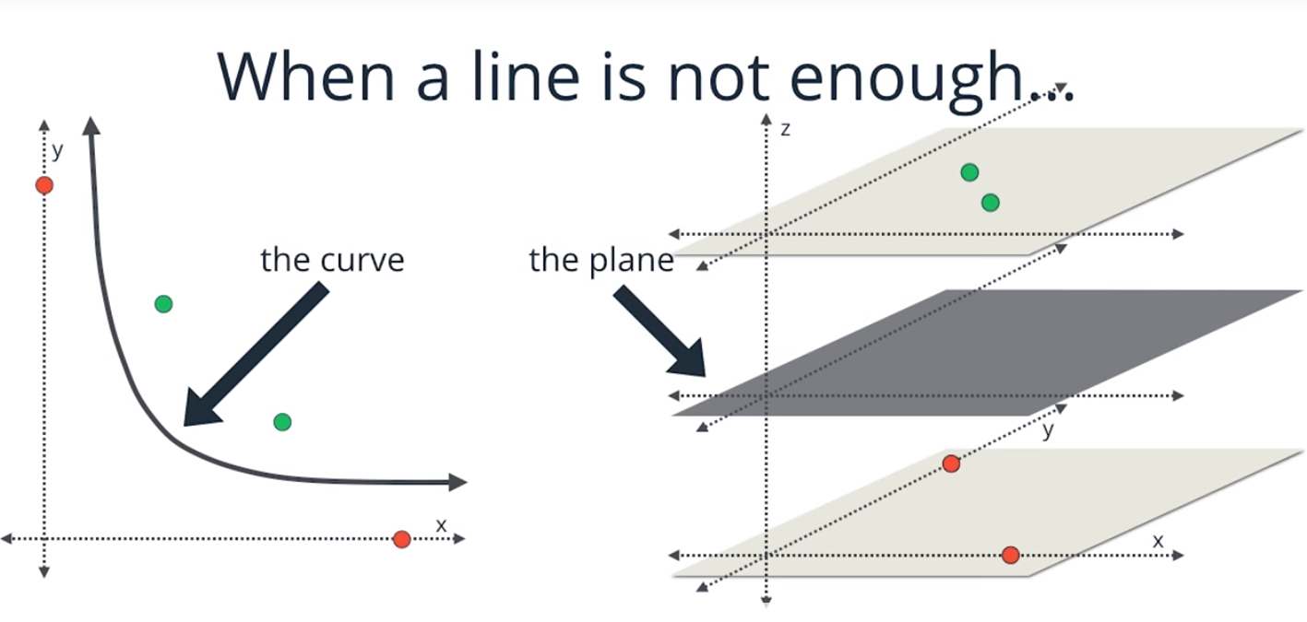
Non-Linear SVM

Slide 61
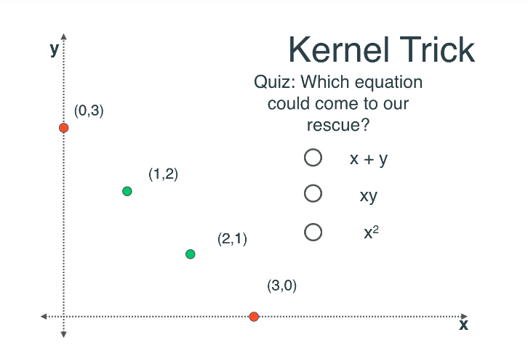
Non-Linear SVM

Slide 62
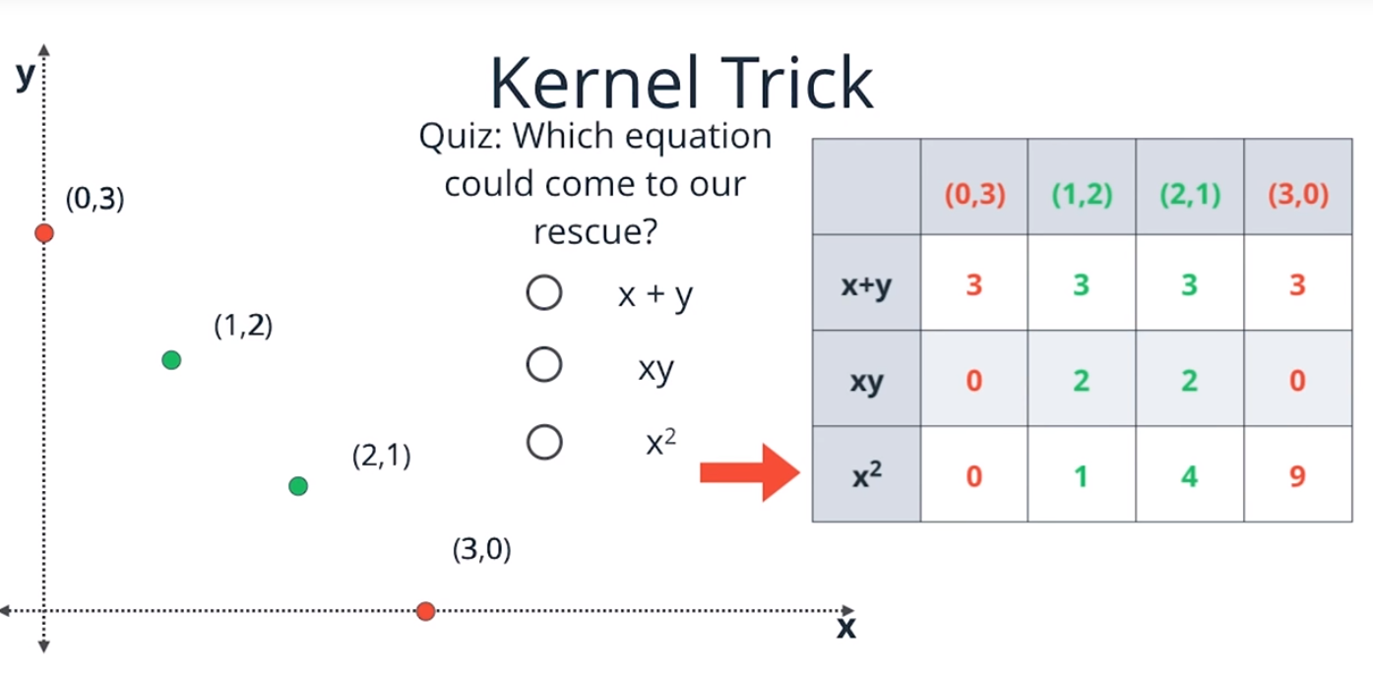
Non-Linear SVM

Slide 63
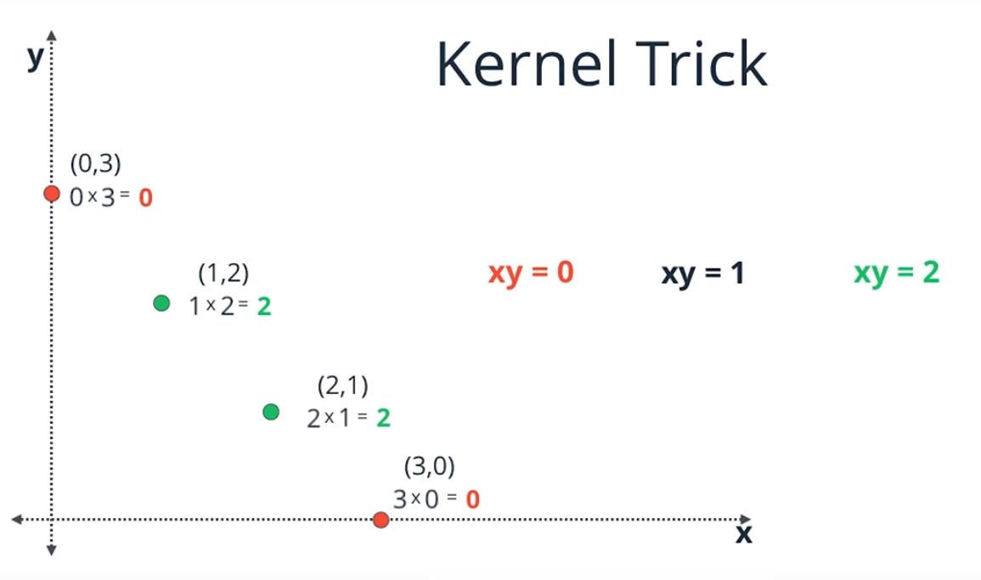
Non – Linear SVM

Slide 64
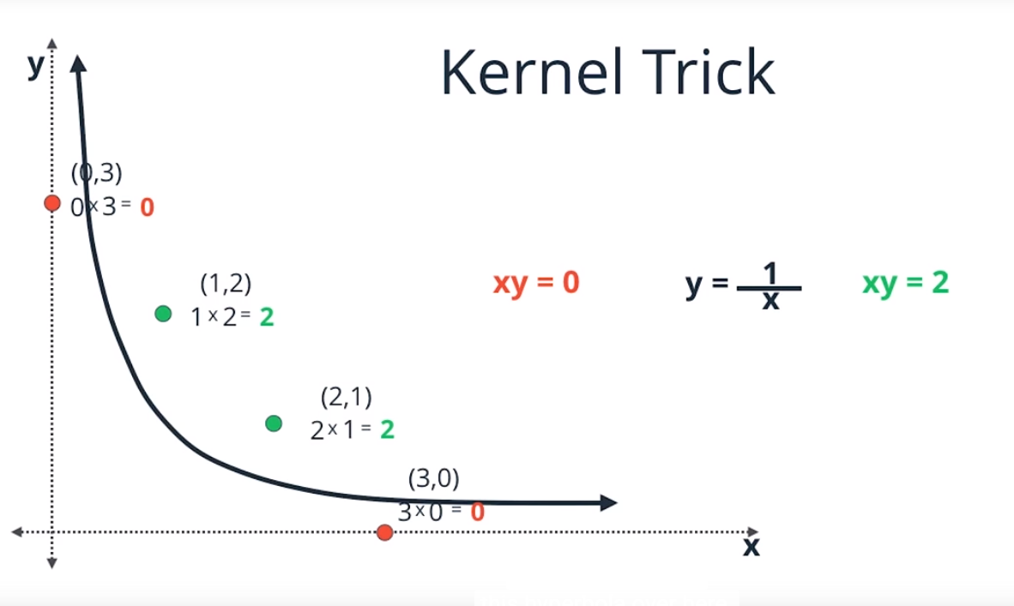
Non – Linear SVM

Slide 65
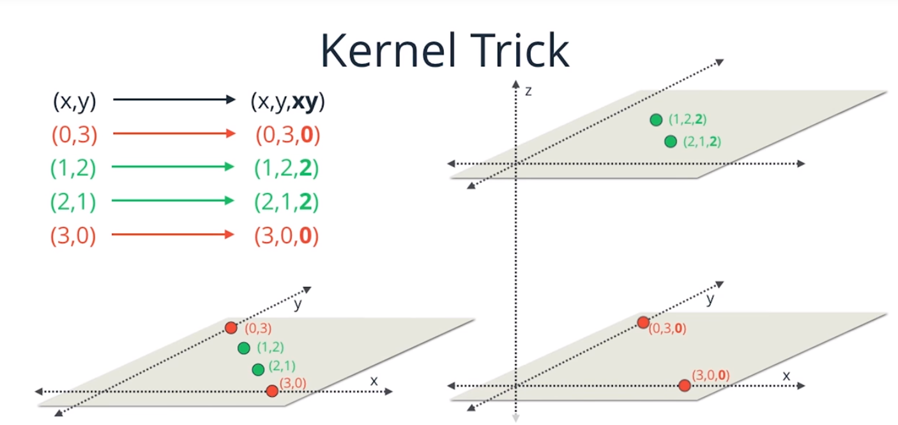
Non – Linear SVM

Slide 66
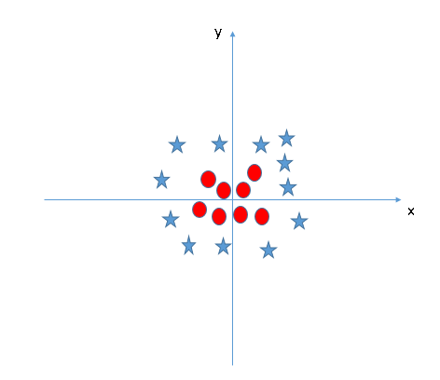
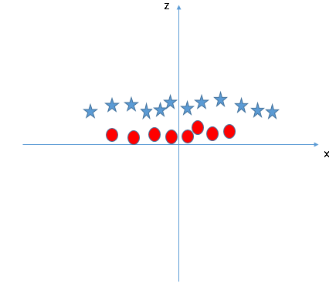
Non-Linear SVM - Example
Z = x^2 + y^2
SVM uses “kernel” functions which take low dimensional input space and transform it to a higher dimensional space

Slide 67
SVM Parameters
Kernel : It defines the function to transform low dimensional input space into higher dimension
Gamma: It defines how far the influence of a single training example reaches
C: It controls the trade-off between smooth decision boundary and classifying training points correctly.

Slide 68
SVM Pros and Cons
Pros:
It works really well with clear margin of separation
It is effective in high dimensional spaces.
It is effective in cases where number of dimensions is greater than the number of samples.
It uses a subset of training points in the decision function (called support vectors), so it is also memory efficient.
Cons:
It doesn’t perform well, when we have large data set because the required training time is higher
It also doesn’t perform very well, when the data set has more noise i.e. target classes are overlapping

Slide 69
Parametric vs Non Parametric
Assumptions can greatly simplify the learning process, but can also limit what can be learned. Algorithms that simplify the function to a known form are called parametric machine learning algorithms. The algorithms involve two steps:
Select a form for the function.
Learn the coefficients for the function from the training data.
Some examples of parametric machine learning algorithms are Linear Regression and Logistic Regression.
Algorithms that do not make strong assumptions about the form of the mapping function are called nonparametric machine learning algorithms. They are also known as Instance-based methods. By not making assumptions, they are free to learn any functional form from the training data.
Non-parametric methods are often more flexible, achieve better accuracy but require a lot more data and training time.
Examples of nonparametric algorithms include k-NN, Support Vector Machines, Neural Networks and Decision Trees.

Slide 70
Performance Metrics
Some of the metrics to evaluate a ML Model performance are:
Classification
Accuracy
Precision
Recall
F1 score
Regression
Mean Absolute Error
Mean Squared Error
R2 Score

Slide 71
Classification Metrics
Accuracy : Proportion of items labelled correctly out of all the items
accuracy = number of correctly identified instances / all instances
Confusion matrix: It’s a 2 by 2 matrix which compares the actual outcomes to the predicted outcomes. The rows are labeled with actual outcomes while the columns are labeled with predicted outcomes.
Sensitivity = True Positives/(True Positives + False Negatives) aka Recall
Out of all the items that are truly positive, how many were correctly classified as positive. Or simply, how many positive items were 'recalled' from the dataset.
Specificity = True Positives/(True Positives + False Positives) aka Precision
Out of all the items labeled as positive, how many truly belong to the positive class. It measures how precise you are at predicting a positive label. Precision is particularly helpful when trying to make sure that your positive predictions are not leading to many false positives, such as medical tests.
F1-Score: F1 score combines precision and recall relative to a specific positive class. The F1 score can be interpreted as a weighted average of the precision and recall, where an F1 score reaches its best value at 1 and worst at 0:
F1 = 2 * (precision * recall) / (precision + recall)

Slide 72
Accuracy Paradox
Accuracy can often be misleading, especially in cases where classes are heavily distributed unevenly through the dataset. Consider the case where you have a dataset of 950 positive items and 50 negative items. Without even using a model, predicting everything to be positive will net a 95% accuracy score. This is known as the Accuracy Paradox. This information doesn't really tell us anything at all. Our precision value would also yield the same percentage of 95%, but this value is more telling. We know that out of all the items classified as positive, 95% truly belong to that positive class. Our recall on the positive class would be 100%. Great! But recall on the negative class is 0%. Accuracy couldn't tell us any of that information.

Slide 73
Regression Metrics
Mean Absolute Error : One way to measure error is by using absolute error to find the predicted distance from the true value. The mean absolute error takes the total absolute error of each example and averages the error based on the number of data points. By adding up all the absolute values of errors of a model we can avoid canceling out errors from being too high or below the true values and get an overall error metric to evaluate the model on.
Mean Squared Error : Mean squared is the most common metric to measure model performance. In contrast with absolute error, the residual error (the difference between predicted and the true value) is squared.
Some benefits of squaring the residual error is that error terms are positive, it emphasizes larger errors over smaller errors, and is differentiable. Being differentiable allows us to use calculus to find minimum or maximum values, often resulting in being more computationally efficient.
R-Squared: Its called coefficient of determination. The values for R² range from 0 to 1, which captures the percentage of squared correlation between the predicted and actual values of the target variable. A model with an R² of 0 is no better than a model that always predicts the mean of the target variable, whereas a model with an R² of 1 perfectly predicts the target variable. Any value between 0 and 1 indicates what percentage of the target variable, using this model, can be explained by the features. A model can be given a negative R² as well, which indicates that the model is arbitrarily worse than one that always predicts the mean of the target variable. R-Square gives us the answer to the question “How much the change in output variable is caused by the change in input variable?”

Slide 74
Causes of Error
Bias: Bias occurs when a model has enough data but is not complex enough to capture the underlying relationships(or patterns). As a result, the model consistently and systematically misrepresents the data, leading to low accuracy in prediction. This is known as underfitting. Simply put, bias occurs when we have an inadequate model. (Pays too little attention to data; does the same thing over and over again; high error on training set)
Variance: When training a model, we typically use a limited number of samples from a larger population. If we repeatedly train a model with randomly selected subsets of data, we would expect its predictions to be different based on the specific examples given to it. Here variance is a measure of how much the predictions vary for any given test sample. (Pays too much attention to data; high error on test set)
Some variance is normal, but too much variance indicates that the model is unable to generalize its predictions to the larger population. High sensitivity to the training set is also known as overfitting, and generally occurs when either the model is too complex or when we do not have enough data to support it.
We can typically reduce the variability of a model's predictions and increase precision by training on more data. If more data is unavailable, we can also control variance by limiting our model's complexity.

Slide 75
Learning Curve
The Learning Curve functionality from sklearn can help us in this respect. It allows us to study the behavior of our model with respect to the number of data points being considered to understand if our model is performing well or not.

Slide 76
Curse of Dimensionality
As the number of features or dimensions grows, the amount of data we need to generalize accurately, grows exponentially.

Slide 77
NumPy & Pandas
Numpy: Numerical Python
It’s a package in python which has lots of functions to work with data.
The most used data structure in numpy is array()
To convert a list in python into numpy array:
Arr = numpy.array(mylist)
Numpy arrays are like lists in Python, except that every thing inside an array must be of the same type, like int or float.
Pandas: Pandas is used for data manipulation in Python.
The three key data structures in Pandas are:
Series (collection of values)
DataFrame (collection of Series objects)
Panel (collection of DataFrame objects)

Slide 78
Linear Regression
Linear regression: Linear regression involves using data to calculate a line that best fits that data, and then using that line to predict scores on one variable from another. Prediction is simply the process of estimating scores of the outcome (or dependent) variable based on the scores of the predictor (or independent) variable. To generate the regression line, we look for a line of best fit. A line which can explain the relationship between independent and dependent variable(s), better is said to be best fit line. The difference between the observed value and actual value gives the error.
The line of best fit can be represented as
Y= bx +c Where Y is the score or outcome variable we are trying to predict
B = regression coefficient or slope
C = Y intercept or the regression constant

Slide 79
Logistic Regression
Extension of linear regression where the dependent variable is categorical and not continuous.
It is a prediction done with categorical variable. It predicts the probability of the outcome variable being true.
In other words, the interest is in predicting which of two possible events are going to happen given certain other information
• Is he a prospective customer ie., likelihood of purchase vs non-purchase ?
• Is he a defaulter for bill payment ie., credit worthiness
• Low claim or high risk for an insurance
• Medicine is it going to work or does not work

Slide 80
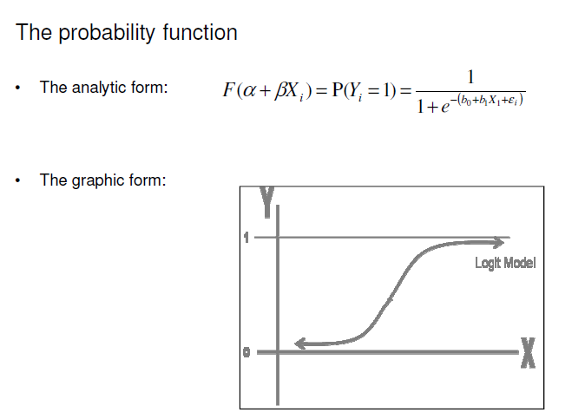
Logistic Regression Function

Slide 81
Logistic Regression Model in R
The function glm() is used to build Logistic regression Model
Mylm = glm(Y~ X1 + X2 + X3, data=df, family=binomial)
Y = Dependent Variable
X1, X2, X3 = Independent Variables
SSE = sum(mylm$residuals^2)
To check summary of the model, use summary(Mylm). One of the metrics shown in summary is AIC value. It is the measure of the quality of model. The preferred model is the one with minimum AIC. AIC stands for Akaike Information Criterion
Once the model is built, the predict function can be used on Test Data Set to predict the values:
predictTrain= predict(Mylm, newdata= testData, type=“response”) [The type=“response” argument tells the predict function to give probabilities. type=“class” will give either TRUE or FALSE]

Slide 82
Decision Trees
A predictive model that uses a set of binary rules to calculate a target value
Used for either classification(categorical variables) or regression(continuous variables)
Tree generating algorithm determines
- Which variable to split at a node
- Decision to stop or make a split again
- Assign terminal nodes to a class

Slide 83
Decision Tree – An Example
Body Temperature
Warm
Cold
Gives Birth
Non-Mammals
Yes
No
Mammal
Non-Mammal

Slide 84
Hunt’s Algorithm
A decision tree is grown in a recursive fashion by partitioning the training records into purer subsets.
Let TR(t) be the training records associated with node t. Let c = {c1,c2,c3….cn} be the class labels
Step 1: If all the records in TR(t) belongs to the same class y(t) then t is the leaf node and will be labeled as y(t)
Step 2: If TR(t) contains records that belong to more than 1 class, a test condition is selected on a attribute to partition the records into smaller subsets. A child node is created for each outcome of the test condition and records in TR(t) are distributed to the children based on the outcomes. The algorithm is then recursively applied to each child node.

Slide 85
CART Model in R
The package used to build and plot CART Model is rpart and rpart.plot.
The function rpart() is used to build CART Model
Mycart = rpart(Y~ X1 + X2 + X3, data=df, method=“class”, minbucket=25)
Y = Dependent Variable
X1, X2, X3 = Independent Variables
Method=“class” tells R to build Classification tree
PRP() function is used to plot the tree.
> Prp(Mycart)
Once the model is built, the predict function can be used on Test Data Set to predict the values:
predictTrain= predict(Mycart, newdata= testData, type=“class”) [The type=“class” is added to get majority class predictions. This is like using a threshold of 0.5]

Slide 86
Significance of “minbucket”
“minbucket” is used to limit the number of splits
It is the minimum number of observations in each subset or bucket.
The smaller the minbucket is, the more the splits will be generated.
If minbucket =0, each bucket will carry 1 observation. This is overfitting. Its super accurate but useless for new observations.
If minbucket is very large e.g it contains all observations, then the model becomes very simple and loses predictive power. In worst case, minbucket=no of all observations.

Slide 87
Measures Used for Split
Let’s say we have a sample of 30 students with three variables Gender (Boy/ Girl), Class( IX/ X)
and Height (5 to 6 ft). 15 out of these 30 play cricket in leisure time. Now, we want to create a model to predict who will play cricket during leisure period? In this problem, we need to segregate students who play cricket in their leisure time based on highly significant input variable among all three.
Gini Index
Information Gain
Gini Index: It says if we select two items from a population at random then they must be of same class and probability for this is 1 if population is pure.
It works with categorical target variable “Success” or “Failure”.
It performs only Binary splits
Higher the value of Gini higher the homogeneity.
CART (Classification and Regression Tree) uses Gini method to create binary splits.

Slide 88
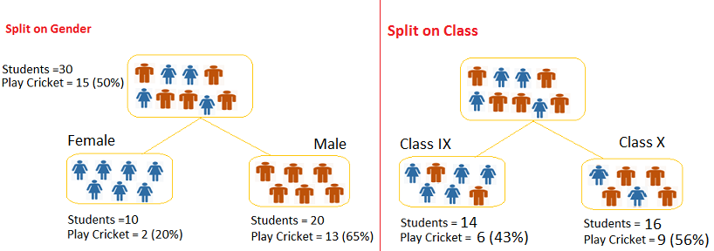
Splits on Gender and Class

Slide 89
Steps to calculate Gini Index
Split on Gender:-
Calculate, Gini for sub-node Female = (0.2)*(0.2)+(0.8)*(0.8)=0.68
Gini for sub-node Male = (0.65)*(0.65)+(0.35)*(0.35)=0.55
Calculate weighted Gini for Split Gender = (10/30)*0.68+(20/30)*0.55 = 0.59
Similar for Split on Class:-
Gini for sub-node Class IX = (0.43)*(0.43)+(0.57)*(0.57)=0.51
Gini for sub-node Class X = (0.56)*(0.56)+(0.44)*(0.44)=0.51
Calculate weighted Gini for Split Class = (14/30)*0.51+(16/30)*0.51 = 0.51
You can see that Gini score for Split on Gender is higher than Class so node will split on Gender.

Slide 90
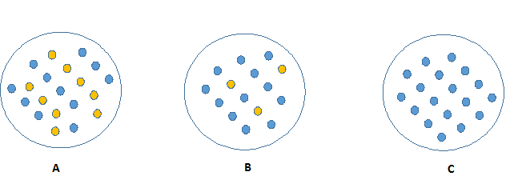
Information Gain
Which Node can be described easily?

Slide 91
Information Gain
Which Node can be described easily?
“C” because it requires less information as all values are similar where as B requires more information to describe it and A would require even more. You can say in other words also that C is a Pure node, B is less Impure and A is more impure.
Less impure node requires less information to describe it and more impure node requires more information. Information theory has a measure to define this degree of disorganization in a system, which is called Entropy. If the sample is completely homogeneous, then the entropy is zero and if the sample is an equally divided it has entropy of one.

Slide 92
Steps to calculate Information Gain
> Calculate entropy of parent node
> Calculate entropy of each individual node of split and calculate weighted average of all sub-nodes available in split.
Example: Let’s use this method to identify best split for student example.
Entropy for parent node = -(15/30) log2 (15/30) – (15/30) log2 (15/30) = 1. Here 1 shows that it is a impure node.
Entropy for Female node = -(2/10) log2 (2/10) – (8/10) log2 (8/10) = 0.72 and for male node, -(13/20) log2 (13/20) – (7/20) log2 (7/20) = 0.93.
Entropy for split Gender = Weighted entropy of sub-nodes = (10/30)*0.72 + (20/30)*0.93 = 0.86
Entropy for Class IX node = -(6/14) log2 (6/14) – (8/14) log2 (8/14) = 0.99 and
X node = (9/16) log2 (9/16) – (7/16) log2 (7/16) = 0.99.
Entropy for split Class = (14/30)*0.99 + (16/30)*0.99 = 0.99
Above you can see that entropy of split on Gender is lower compare to Class so we will again go with split Gender. We can derive information gain from entropy as 1- Entropy.

Slide 93
Random Forests
Ensembling: Ensembling is a process of combining the results of multiple models to solve a given prediction or classification problem.
Random Forests: Random Forests is an ensemble modeling technique that works by building large number of CART tress. It takes a subset of observations and a subset of variables to build a decision trees. Each tree will play a role in determining the final outcome.
A random forest builds many trees. In forming each tree, it randomly selects the independent variables. This means that data used as training data for each tree is selected randomly with replacement. Each tree will give its output. The final output will be a function of each individual tree output.
The function can be:
Mean of individual probability outcomes
Vote Frequency

Slide 94
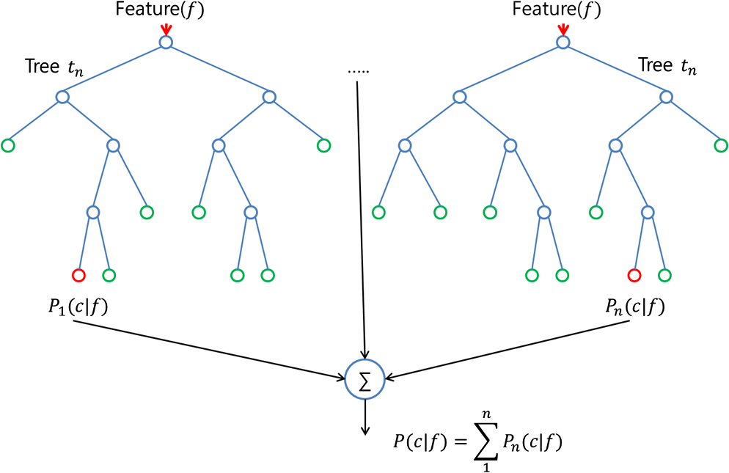
Random Forests

Slide 95
Random Forest Model in R
Random Forest is used to increase the prediction accuracy of CART.
The package used to build and plot Random Forest Model is randomForest and rpart.plot.
The function rpart() is used to build CART Model
Mycart = rpart(Y~ X1 + X2 + X3, data=df, method=“class”, minbucket=25)
Y = Dependent Variable
X1, X2, X3 = Independent Variables
Method=“class” tells R to build Classification tree
PRP() function is used to plot the tree.
> Prp(Mycart)
Once the model is built, the predict function can be used on Test Data Set to predict the values:
predictTrain= predict(Mycart, newdata= testData, type=“class”) [The type=“class” is added to get majority class predictions. This is like using a threshold of 0.5]

Slide 96
Random Forest Parameters
ntree: Number of trees to grow. This should not be set to too small a number, to ensure that every input row gets predicted at least a few times. The default for ntree is 500. This parameter implicitly sets the depth of your trees.
Nodesize: Equivalent of minbucket. A smaller value of nodesize leads to bigger trees

Slide 97
A Movie Example
Suppose, you want to watch a movie ‘X’ . You ask your friend ‘Amar’ if you should watch this movie.
Amar asks you a series of questions:
What previous movies you watched? Which of these movies you liked or disliked?Is X a romantic movie? Does Salman Khan act in movie X?
….. And several other questions. Finally Amar tells you either Yes or No.
Amar is a decision tree for your movie preference.
But Amar may not give you accurate answer. In order to be more sure, you ask couple of friends – Rita, Suneet and Megha, the same question. They will each vote for the movie X. (This is ensemble model aka Random Forest in this case)
If you have a similar circle of friends, they may all have the exact same process of questions, so to avoid them all having the exact same answer, you’ll want to give them each a different sample from your list of movies. You decide to cut up your list and place it in a bag, then randomly draw from the bag, tell your friend whether or not you enjoyed that movie, and then place that sample back in the bag. This means you’ll be randomly drawing a sub sample from your original list with replacement (bootstrapping your original data)
And you will just make sure that , each of your friends asks different questions randomly.

Slide 98
To test the accuracy of a Model on Test set in R
The steps are as follows:
Run the model on Test Data.
mymodel=lm(…….) or glm(…..) or rpart(…..) or randomForest(…..)
Predict the values onto Testing set.
predictmymodel=predict(mymodel, newdata=Test, type=“ “)
3. table(“Outcome Variable, predictmymodel)

Slide 99
K- fold Cross Validation in R
Caret and e1701 packages are used
Step1: Define cross validation experiment. E.g for 10 fold validation:
numFolds = trainControl( method = "cv", number = 10 )
cpGrid = expand.grid( .cp = seq(0.01,0.5,0.01))
This will define the cp parameters to test as numbers from 0.01 to 0.5 in incremets of 0.01.
Step 2: Perform the cross validation
train(Dependent Var Name ~ Independent Variables, data = TrainingData, method = "rpart", trControl = numFolds, tuneGrid = cpGrid )
This will give the optimum cp to be used.

Slide 100
Netflix Story
Netfix is an online DVD rental and streaming video Service.
It ran a contest asking participants to predict user ratings for movies.
Provided training set of about 100 million ratings and test set of about 3 million user ratings.
Prize money was 1 million dollars if the new algorithm beats their existing system by more than 10%
29 days after last call was announced, on July 25, 2009, the team The Ensemble submitted a 10.09% improvement
BellKor’s Pragmatic Chaos won the competition and the $1,000,000 grand prize

Slide 101
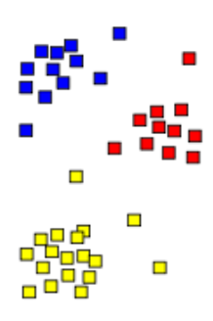
Clustering
Clustering is an unsupervised method. It is used to segment the data into similar groups instead of prediction.
It does not predict anything but can be used to improve the accuracy of predictive methods.

Slide 102

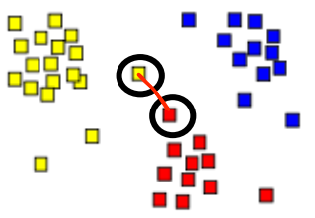
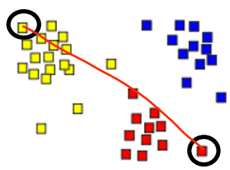
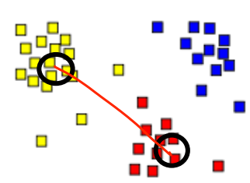
Distances for Clustering
Euclidean Distance(As-the-crow-flies Distance): Its the straight line between 2 points
Distances between Clusters:
Minimum Distance: Distances between the points which are closest
Maximum Distance: Distances between the points that are farthest
Centroid Distance: Distance between centroid of clusters
Minimum Maximum Centroid

Slide 103

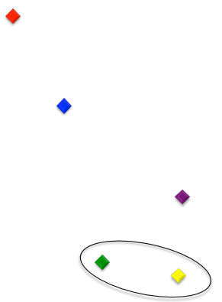

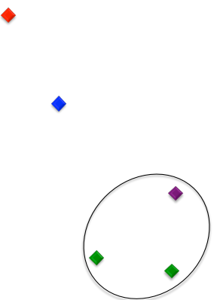
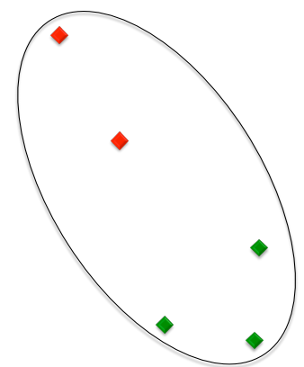
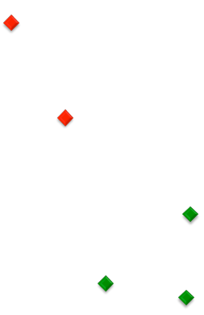
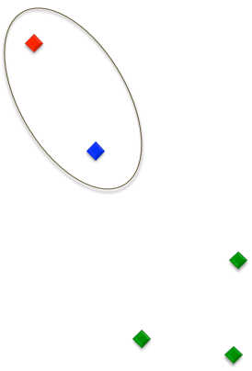
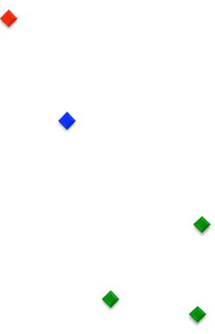
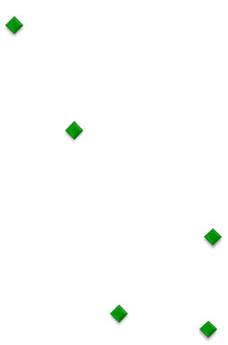
Hierarchal Clustering
Start with each data point in its own cluster
Combine two nearest clusters(Euclidean or centroid)
Repeat the process till all data points belong to same cluster.

Slide 104
Hierarchal Clustering in R
There are 2 steps to Hierarchal clustering :
Compute distances between all data points
distances = dist(df$colname, method=“Euclidean”)
Cluster the points
mycluster = hclust(distances, method=“ward”)
Plotting the dendogram: plot(mycluster)
Grouping the clusters: clusterGroups = cutree(mycluster, k = 10)

Slide 105
K Means Clustering
It aims at partitioning the data into k clusters in a way that each data point belongs to the cluster whose mean is nearest to it.
Lets say you have some data points and you want to group them into 3 clusters. So k=3.
1. You will start with randomly assigning the data points into 3 clusters.
2. Then, you will calculate the centroid or mean of each cluster
3. Now the data points will be reassigned to the closest cluster mean.
4. Recompute cluster centroids
5. Repeat steps 4 and 5 until no improvement is made

Slide 106
Text Analytics
Process of extracting high quality information from Text.
Text mining can help an organization derive potentially valuable business insights from text-based content such as word documents, email and postings on social media streams like Facebook, Twitter and LinkedIn.
Natural Language Processing is another term used for “Text Mining” or “Text Analytics”
The most basic method of doing text analytics is “bag of words”. It counts the number of times each word appears in a text and uses these counts as independent variables. It is used as baseline in text analytics and NLP projects
Before applying text analytics methods, pre-processing of the text can improve the quality of the analytics.

Slide 107
Bag of Words
Bag of words counts the number of times each word appears in the text and uses these counts as independent variables.
“This is a good country. I will recommend the trip to this country to my friends”
This = 2 , is =1, a = 1, Good = 1, Country = 2, I = 1
Will =1, Recommend=1,The=1, Trip =1, tp=1, tp=1, my=1, friends=1
Before applying bag of words, preprocessing should be done, to improve the performance.

Slide 108
Text Pre-Processing
Basic pre-processing includes:
Converting all text into all uppercase or lowercase, so that the algorithm does not treat the same words in different cases as different
Removing everything that isn’t a standard number or letter
Stop words like is, the, at etc can be removed
Stemming: It is used to represent words with different endings as the same word e.g argue, argued, argues and arguing can be represented by a single word

Slide 109
Text Analytics Steps in R
The steps are as follows:
Prepare the corpus.
corpusTitle = Corpus(VectorSource(trials$title))
Covert the corpus to lowercase.
corpusTitle = tm_map(corpusTitle, tolower)
Convert the corpus into Plain text Document
corpusTitle = tm_map(corpusTitle, PlainTextDocument)
Remove punctuations from corpus
corpusTitle = tm_map(corpusTitle, removePunctuation)
5. Remove English stop words
corpusTitle = tm_map(corpusTitle, removeWords, stopwords("english"))
Stem the corpus
corpusTitle = tm_map(corpusTitle, stemDocument)
Prepare a document term matrix (It’s a matrix where rows represent the documents and columns represent the words in those documents. The values in matrix are the no of times that word appears in each document)
dtmTitle = DocumentTermMatrix(corpusTitle) 8. Remove sparse terms
dtmTitle = removeSparseTerms(dtmTitle, 0.95)
9. Convert into a dataframe
dtmTitle = as.data.frame(as.matrix(dtmTitle))

Slide 110
Setting up Twitter for Sentiment Analysis
Packages Required: TwitteR, plyr
Create an application by logging in your Twitter account: https://apps.twitter.com/
Note down your API Key, API Secret, Access Token and Access Token Secret
Create variables in you R session: api_key, api_secret, access_token and access_token_secret by assigning the above values
Run the command:
setup_twitter_oauth(api_key,api_secret,access_token,access_token_secret)
5. tweets <- searchTwitter(search.string, n=no.of.tweets, lang="en")

Slide 111
Dimensionality Reduction or Feature Selection
Dimensionality Reduction refers to the process of reducing the no of variables in the given data set with no or little loss of information
The dimensions can be directly filtered or some dimensions can be combined
Some Techniques to implement Dimensionality Reduction are:
1. Identify variables which have 40-50% Missing Values. Such columns can be dropped.
2. Identify variables which have very low variance. Such columns can be dropped.
3. Decision Trees and Random Forests
4. Select only one of the highly correlated variables
5. Factor Analysis and PCA: If some variables are highly correlated, they can be grouped together. Each group represents a factor.
Principal Component Analysis: In this, variables are transformed into a new set of variables, which are linear combination of original variables.

Slide 112
PCA and Factor Analysis
Principal component analysis (PCA) and Factor analysis are data reduction methods used to re-express multivariate data with fewer variables.
The goal of these methods is to re-orient the data so that a multitude of original variables can be summarized with relatively few “factors” or “components” that capture the maximum possible information (variation) from the original variables.
In R, we follow 3 steps:
Import the data
Use PCA to find number of factors
Do Exploratory Factor Analysis

Slide 113
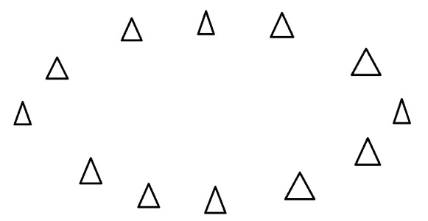


What are Principal Components?
Principal components are the directions where there is the most variance, the directions where the data is most spread out.
Imagine that the triangles are points of data. To find the direction where there is most variance, find the straight line where the data is most spread out when projected onto it.
A horizontal line is the principal component in this example. On this line the data is way more spread out, it has a large variance.
When we get a set of data points, like the triangles above, we can deconstruct the set into eigenvectors and eigenvalues. Eigenvectors and values exist in pairs: every eigenvector has a corresponding eigenvalue. An eigenvector is a direction, in the example above the eigenvector was the direction of the line (vertical, horizontal, 45 degrees etc.) . An eigenvalue is a number, telling you how much variance there is in the data in that direction, in the example above the eigenvalue is a number telling us how spread out the data is on the line. The eigenvector with the highest eigenvalue is therefore the principal component.

Slide 114


Rotation

Slide 115

A little Maths
Matrix Algebra:
Eigenvectors are special case of matrix multiplication. In the first example, the resulting vector is not an integer multiple of the original vector, whereas in the second example, the example is exactly 4 times the vector we began with. The vector in the second example is called eigen vector for its “transformation” matrix. The value “4” is called eigenvalue.

Slide 116
PCA: Under the hood
In PCA, internally R forms the covariance matrix of different dimensions. It then calculates the eigenvectors and eigenvalues of this matrix.
Eigenvector with the highest eigenvalue is the principle component of the data set. This eigenvector represents the most significant relationship between data dimensions.
In general, once eigenvectors are found from the covariance matrix, the next step is to order them by eigenvalue, highest to lowest. This gives you the components in order of significance. Now, if you like, you can decide to ignore the components of lesser significance. You do lose some information, but if the eigenvalues are small, you don’t lose much.
If you leave out some components, the final data set will have less dimensions than the original.

Slide 117
Market Basket Analysis
Many businesses accumulate huge quantities of data from day to day operations
This data can be analyzed to determine the purchasing behavior of customers
{Diapers} -> {Beer}
The rule indicates that there is a strong relationship between the sale of diapers and sale of beers. Customers who bought diapers also bought beer.
TID | Items
1 | {Bread,Milk}
2 | {Bread,Diapers,Beer,Eggs}
3 | {Milk,Diapers,Beer,Cola}
4 | {Bread,Milk,Diapers,Beer}
5 | {Bread,Milk,Diapers,Cola}

Slide 118
Applications of Association Analysis
There are many applications of association:
Product recommendation – like Amazon’s “customers who bought that, also bought this”
Music recommendations – like Last FM’s artist recommendations
Medical diagnosis
Content optimisation – like in magazine websites or blogs

Slide 119
Association Analysis: Concepts
Imagine 10000 receipts sitting on your table. Each receipt represents a transaction with items that were purchased. The receipt is a representation of stuff that went into a customer’s basket – and therefore ‘Market Basket Analysis’.
We can represent our items as an item set as follows:
I = { i₁,i₂,…,i_{n} }
The “support count” of an itemset is the count of transactions that contain this itemset.
Therefore a transaction is represented as follows:
t_{n} = { i_{j},i_{k},…,i_{n} }
This gives us our rules which are represented as follows:
{ i₁,i₂} => { i_{k}}
Or X => Y
Which can be read as “if a user buys an item in the item set on the left hand side, then the user will likely buy the item on the right hand side too”. A more human readable example is:
{coffee,sugar} => {milk}
If a customer buys coffee and sugar, then they are also likely to buy milk.

Slide 120
Association Analysis: Concepts
The “support count” of an itemset is the count of transactions that contain this itemset.
The support count for {Beer,Diapers,Milk} is 2
The strength of an Association Rule can be measured in terms of Support and Confidence
Support: The fraction of transactions that contain that item set/items. It determines how often a rule is applicable to a dataset. Support = (X U Y)/N
e.g if the rule is: {Milk,Diapers} -> {Beer}
XUY = Support count of {Milk,Diapers,Beer} =2; N=5; Support = 2/5=0.4
Confidence: Probability that a rule is correct for a new transaction with items on the left. Confidence = (Support Count X U Y)/Support Count of X
Support count of {Milk,Diapers,Beer} =2;
Support Count of {Beer} = 3; Confidence = 2/3=0.67
Lift: It is the ratio of the support of the items on the LHS of the rule co-occuring with items on the RHS divided by probability that the LHS and RHS co-occur if the two are independent.
Lift = (Support Count X U Y)/(Support Count of X)*(Support Count of Y)
If lift is greater than 1, it suggests that the precense of the items on the LHS has increased the probability that the items on the right hand side will occur on this transaction.

Slide 121
Association Analysis: Rules Generation
Given a set of transactions T, find all the possible rules having support>=minsupport and confidence>=minconfidence.
A brute-force approach will compute the support and confidence for every possible rule. The no of possible rules extracted from a data set that contains d items is
R= 3^{d} - 2^{d} +1
For a dataset with 6 items, it will generate 602 rules. More than 80% of the rules will be discarded after applying minsupport = 20% and minconfidence=50%
An approach to improve the performance here will be:
First find out the item sets that satisfy the minsupport threshold. These item sets are called frequent itemsets.
Extract all the high-confidence rules from the frequent item sets found in step1. These rules are called strong rules.

Slide 122
Using data to “Organize” Products
Large clusters of co-occuring items should probably be placed in their own category / theme
Long lists of rules (including ones with low support and confidence) can be used to put recommendations at the bottom of product pages and on product cart pages. The only thing that matters for these rules is that the lift is greater than one. (And that we pick those rules that are applicable for each product with the high lift where the product recommended has a high margin.)
In the event that doing the above (3) drives significant uplift in profit, it would strengthen the case to invest in a recommendation system, that uses a similar algorithm in an operational context to power automatic recommendation engine on your website.

Slide 123
Survival Analysis
Models time to an event
Its also known as duration analysis, transition analysis, failure-time analysis and time-to-event analysis
Survival analysis is applied when the data set includes subjects that are tracked until an event happens (failure) or we lose them from the sample. We are interested in how long they stay in the sample (survival).
Example: Time to loan repayment, time to get a job after graduation, time to death after a disease
Why linear regression can’t be used:
> Non-Normally distributed outcome
> Censoring
> May or may not be multivariate analysis
Requirements of Survival Analysis:
Definition of an event
Time Scale – month, year
Origin of the event
Time to event is random variable

Slide 124
Pecularities of Survival Analysis
Individuals do not enter the study at the same time
When the study ends, some individuals may not have experienced the event yet
Some individuals may drop out or get lost in the middle of the study
Above 2 points are called censoring.
Density Function – f(t) = P(T=t) Probability of event happening before time t.
Survival Function – S(t) = P(T>=t) Probability that event will take atleast time t.
S(t) = 1- f(t)
Hazard Rate: It is the probability that the duration will end after time t, given that it has lasted until time t = f(t)/S(t)
The hazard rate is the probability that an individual will experience the event at time t while that individual is at risk for experiencing the event.

Slide 125
Steps in Survival Analysis
Non-Parametric Procedure:
Sort the observations based on duration from smallest to largest
For each duration, determine the number of observations at risk n_{j} (those still in sample) , the number of events d_{j} and the number of censored observations m_{j}
Calculate the hazard function :
d_{j}/n_{j}
4. The Kaplan-Meier estimator of the survival function – take the ratios of those without
events over those at risk and multiply that over time. It will be a decreasing step
function with a jump at each discrete event time.
Time | No at Risk(n_{j}) | No of Events(d_{j} ) | No of Censored Observations | Hazard Function | Cumulative Hazard Function | Survival Function
3 | 100 | 10 | 3 | 10/100=0.1 | 0.1 | 1-0.1=0.9
4 | 100-10-3=87 | 3 | 2 | 3/87=0.034 | 0.1+0.034=0.134 | 0.9*(1-0.034) =0.87
5 | 87-3-2=82 | 6 | 1 | 6/82=0.073 | 0.134+0.073=0.207 | 0.87*(1- 0.073)=0.81

Slide 126

Survival Analysis: An example
We want to study the unemployment duration – the length of time it takes someone to find a full-time
Dependent variable: duration (number of periods being unemployed), event (finding a job)
Independent variables: log wage, claim unemployment insurance, and age.
Subjects tracked from 1 to 28 periods. They either find a job (event) or are still looking (censored). Number of subjects is 3,343; Number of failures is 1,073 or 32% of sample has failed. Incidence rate is 5.13% which is the number of failures divided by the time at risk.

